Slide 1
DOE Meeting 11/06/2024
Stream project update
Notes:
Good afternoon! For those who don’t know or have forgotten about me, I’m Sam. I am first year PhD and I am doing my dissertation on the stream side of the flatwoods. I am most definitely my field work, data collecting, perfecting methodologies. What I’m showing today is not fully realized or analyzed so I am treating this as an introduction to my research interest and a project update.

Slide 2
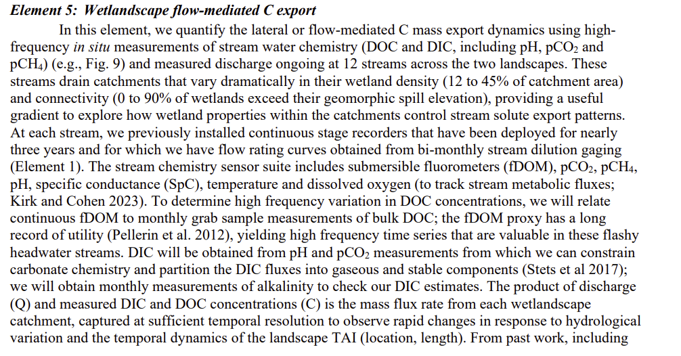
Stream carbon origin, its fate, and at what temporal scale.
Notes:
Within the overarching DOE project, I fit snuggly in element 5. In short, we promised to develop a better understanding of how flatwood carbon enters the streams, where it goes, and when does this happen.
We committed to using high-frequency in-situ measurements and explore the fluxes and fates of C carbon, whether inorganic and organic, dissolved or particulate.

Slide 3
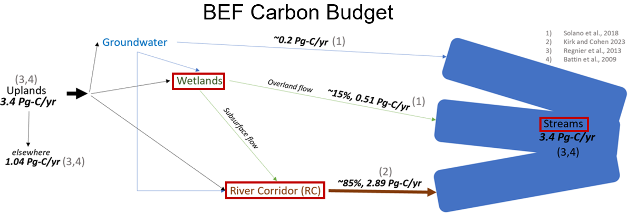
Dissertation Objectives:
Chapter 1: Use long-term, high-frequency data to track spatial and temporal variation (80%).
Chimney (externally sourced) vs Reactor (internally produced) Pathway
Chapter 2: Quantify and estimate riparian corridor carbon fluxes via groundwater carbon samples (50%).
Chapter 3: Longitudinally sample flatwood, headwater streams to track how carbon accumulates downstream (10%).
Notes:
So, chapter 1 is almost verbatim what element 5 promised. I have high-frequency, long-term sensors deployed in 9 streams across 9 different drainage basins and chapter objective is to observed the spatial and temporal trends in stream carbon. In addition to this, I’d like to parse between stream carbon that is produced internally, or externally sourced.
Zooming out, Chapter 2 is more focused the riparian corridor, so the stream and its riparian wetland. I suspect the RC is the primary source of stream carbon yet riparian wetland fluxes to streams are understudied in the literature…
Zooming out further , for chapter 3, I plan on sampling longitudinally along three streams to observe how carbon accumulates downstream. I plan on including elements and findings from chapter 1 and 2 to create a carbon budget of the Bradford Forest that can hopefully be used to inform carbon-credit management decisions.

Slide 4
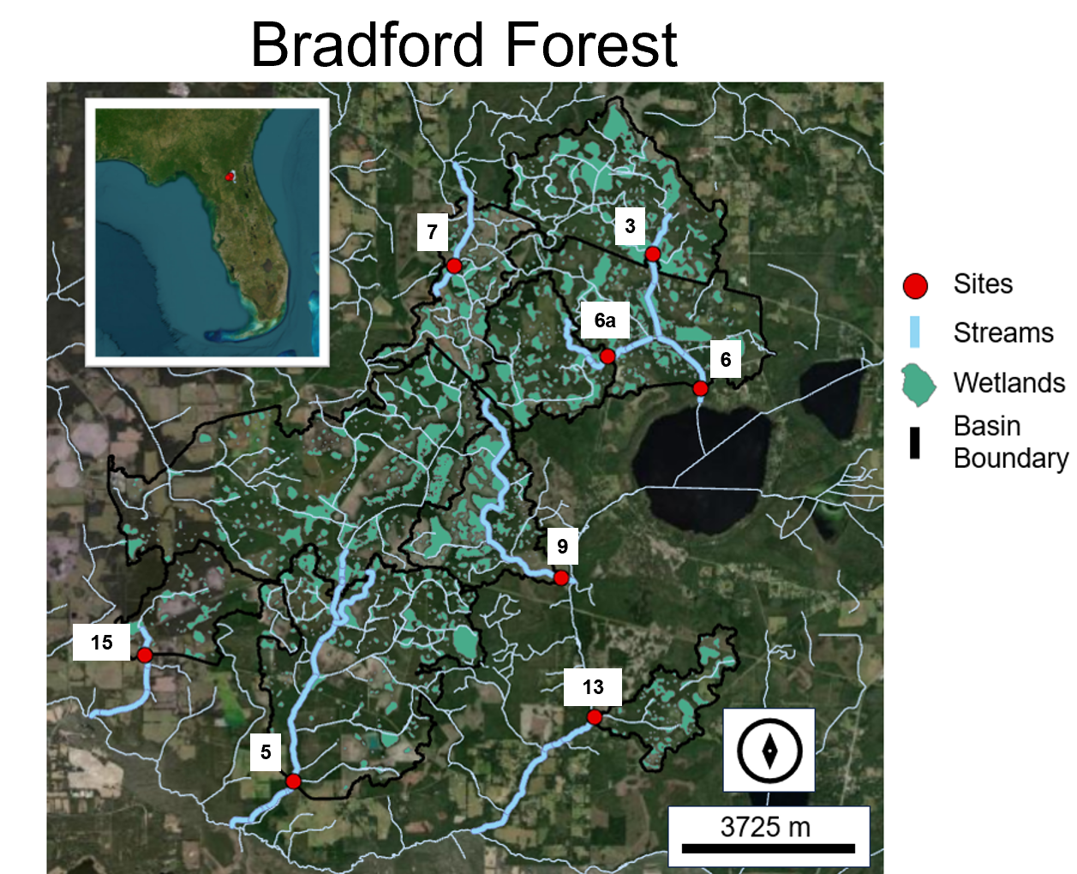
Notes:
Here is an overview of my sites for chapter 1. Each site is equipped with a suite of sensors measuring depth, DO, pH, and CO2.
The red boxes are my sites for chapter 2. Here I have in stalled wells along the river corridor to sample gw from
And lastly, the green boxes are my chapter 3 sites where I plan on sampling longitudinally and taking point readings.

Slide 5
Maybe a table of everything and progress
Notes:
Along with sensor work, I am also taking water and gas samples to again include all species of carbon and paint a holistic picture of the landscape. I’m probably doing too much and its overkill but who knows where the project will take us! Maybe I’ll need that fDOM or cation data!

Slide 6
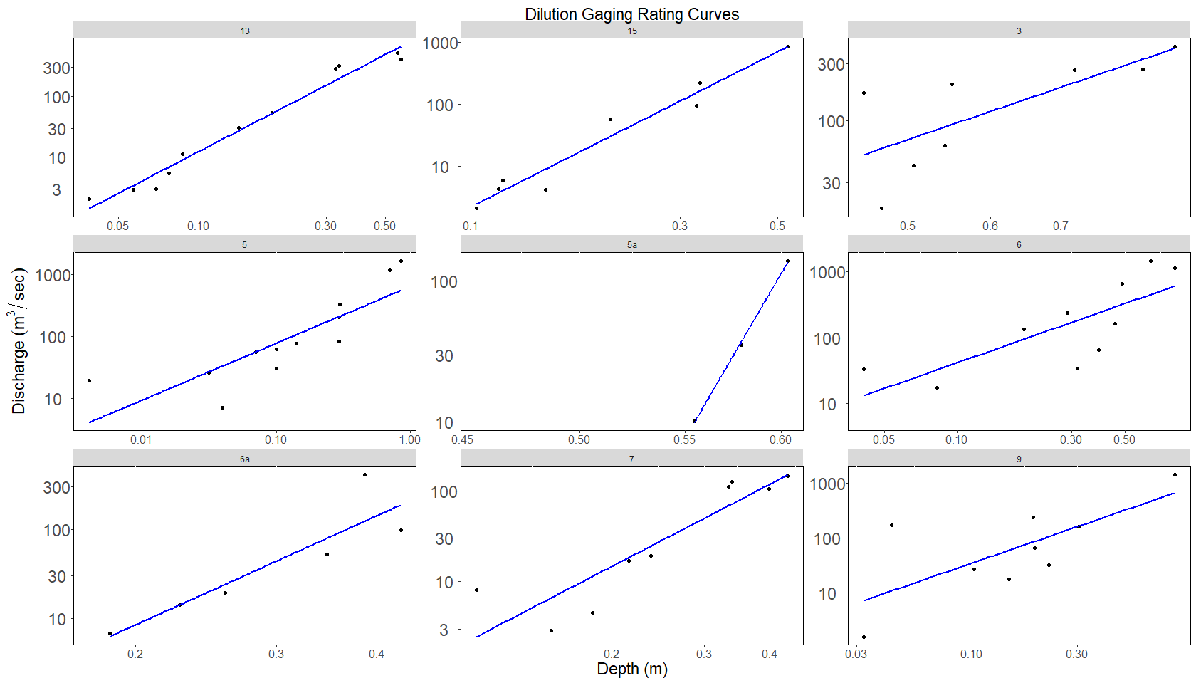
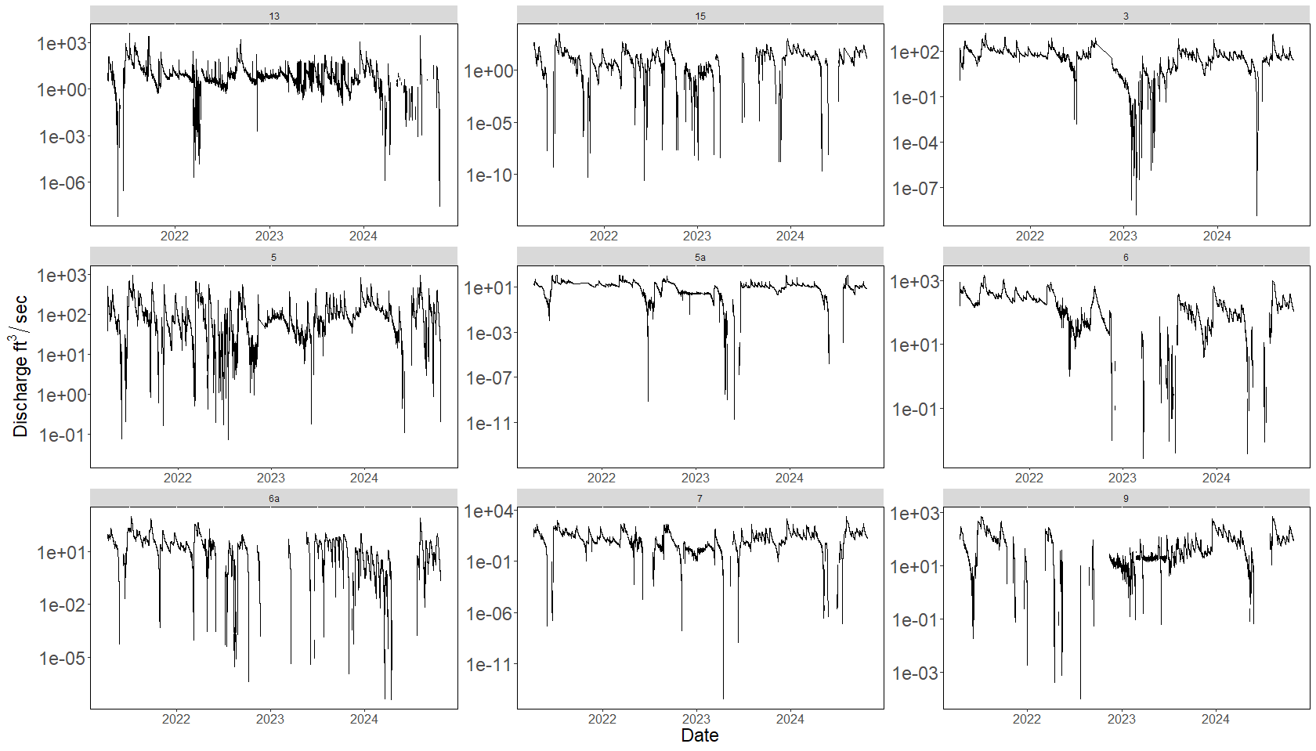
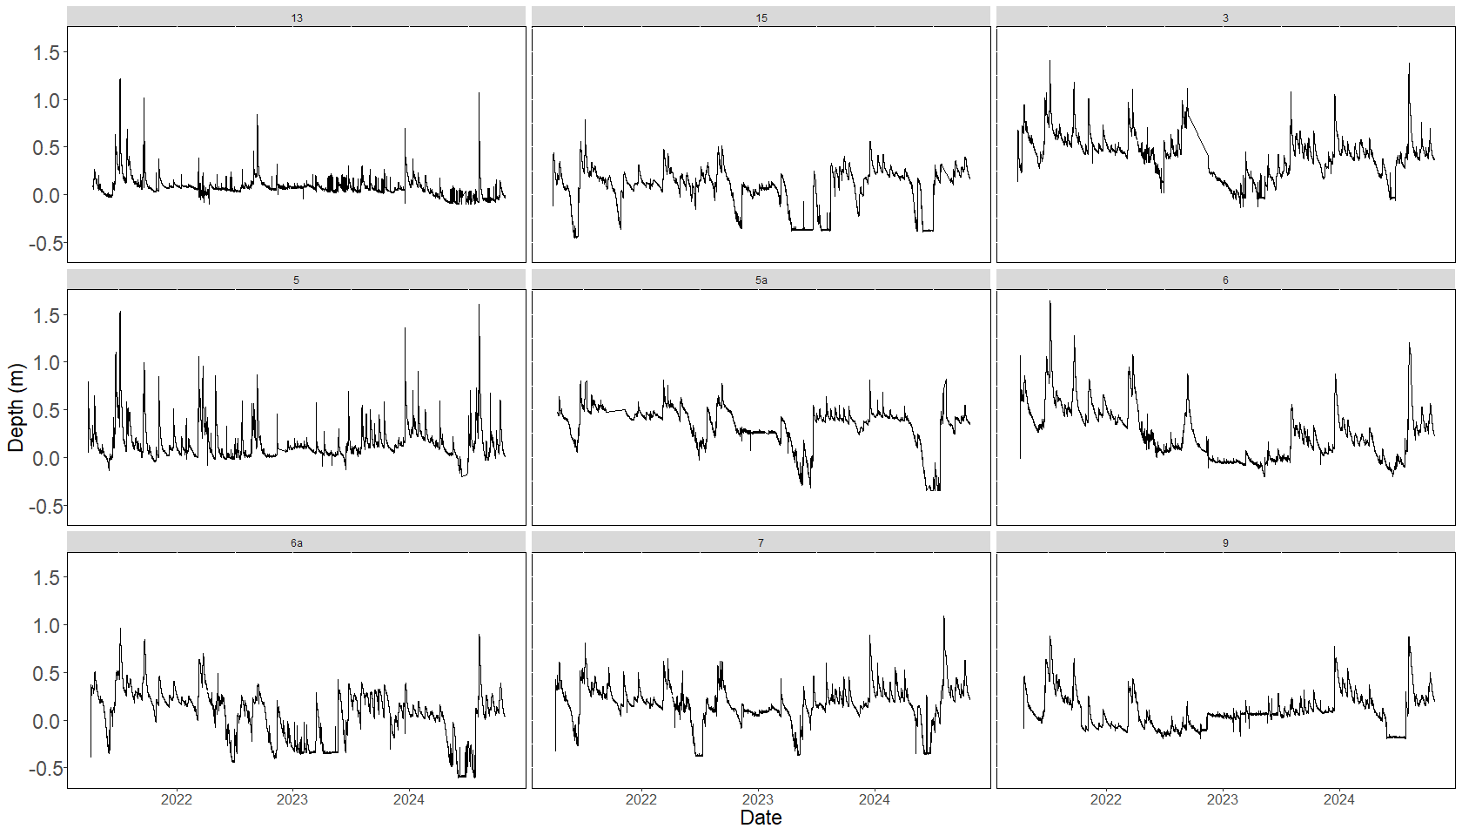
Notes:
As an overview, here are the hydrographs for each of my 9 streams. The PT sensors have been deployed longer than I have been a student so we have a clear idea of each regime. Some maintain flowing water year-round, some go dry, some are either puddles or rapids.
Josh and I, but mainly Josh, have been using salt injections or pulses to measure discharge, and from there, create a rating curve with depth. We are still working on these rating curves and many of the calculations still need tinkering but as of now these are our discharge estimates. All these streams are relatively flashy with majority of them drying out out in the dead of summer

Slide 7
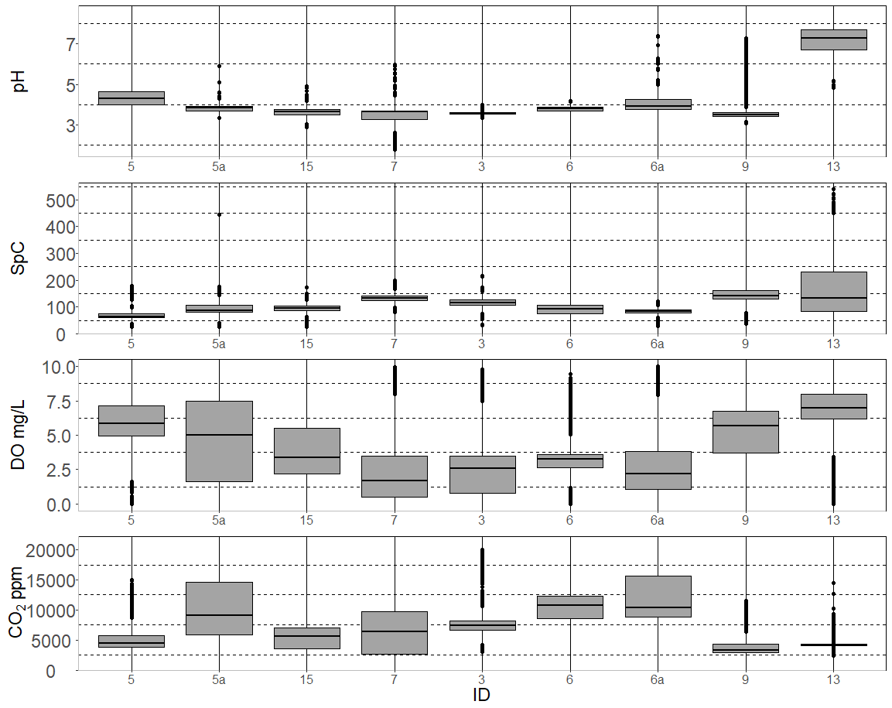
Notes:
This is just a brief overview of the chemical signatures of each streams. I have separated by north and south side. They are all unique from one another with some being super high in CO2 and others not,
13 is spring fed
5a feeds the sinkhole
5 and 9 discharge directly into the Sampson River
3 feeds into 6 before discharging into Sampson Lake

Slide 8
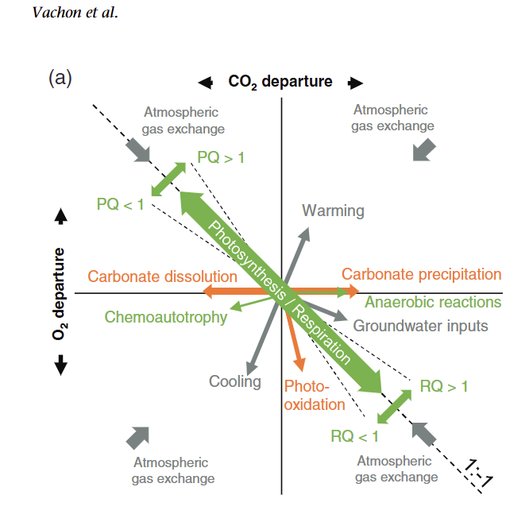
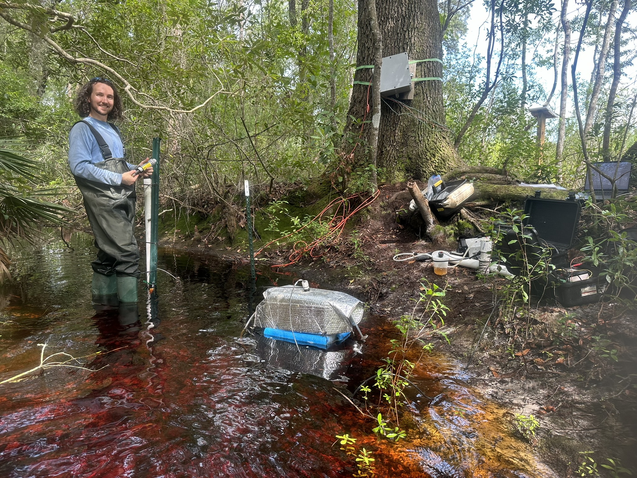
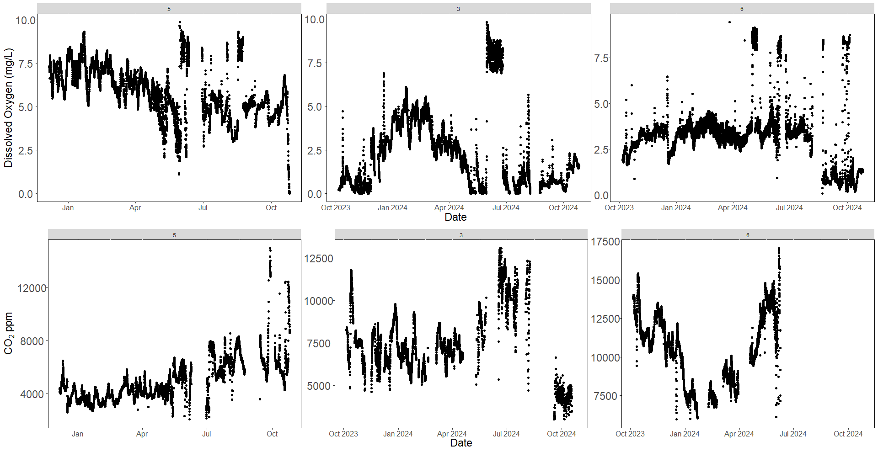
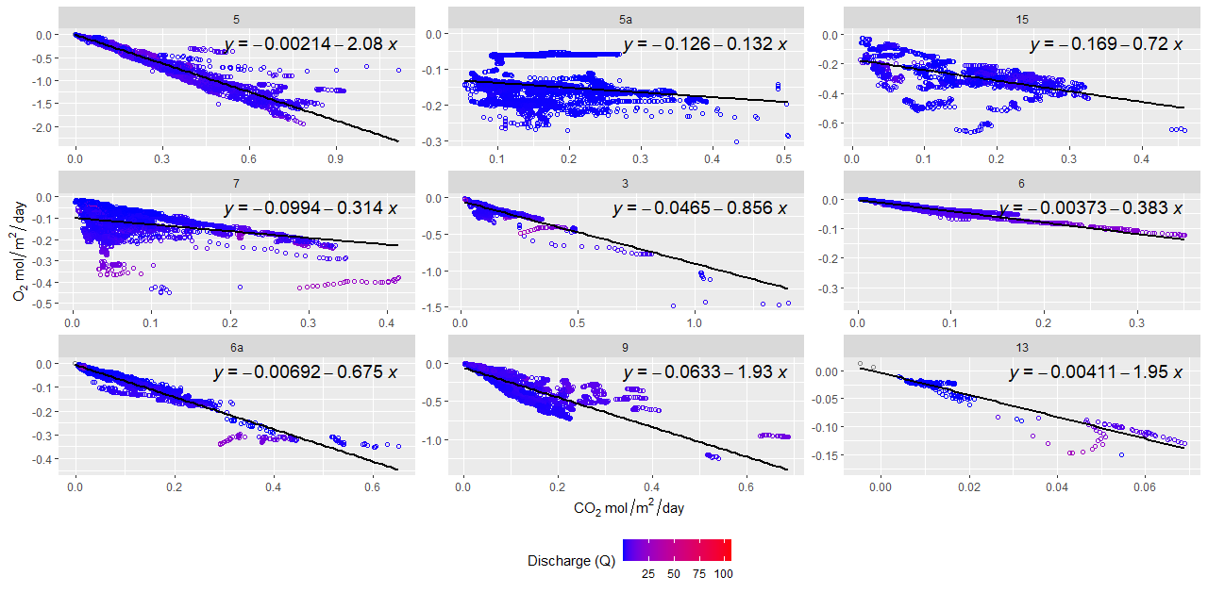
Notes:
As I mentioned, a major element of my chapter 1 is to parse total CO2 into internally produced and externally sourced. This will be inferred by observing O2-CO2 dynamics. Using concepts of steam metabolism ,if every mol O2 produced a mol CO2 consumed, then the remaining, unaccounted for CO2 must by externally sourced. So, I will be using a mix of stream metabolism and O2-CO2 dynamic models to parse between the two.
During the last meeting, this paper was mentioned Vachon et al. 2020. Essentially, if you plot the flux of O2 against the flux CO2, the shape of the cloud depicts scope of CO2-O2 dynamics. Negative fluxes mean the gas is undersaturated while positive fluxes mean the gas is supersaturated. If 1mol of CO2 lost equals one mol of DO produced, the clouds should roughly fall along 1-1 slope. Any deviations from this 1-1 slope hints at external contributions.
Looking at a snapshot of the DO and CO2 time series, you can see they are somewhat couple an experience the same trends in seasonality. By plotting the CO2-O2 fluxes against each other, its clear most of the sites are relatively paired.

Slide 9
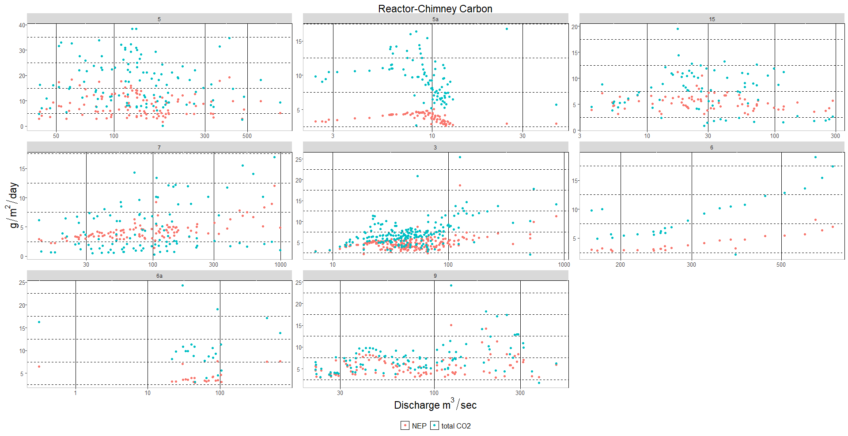
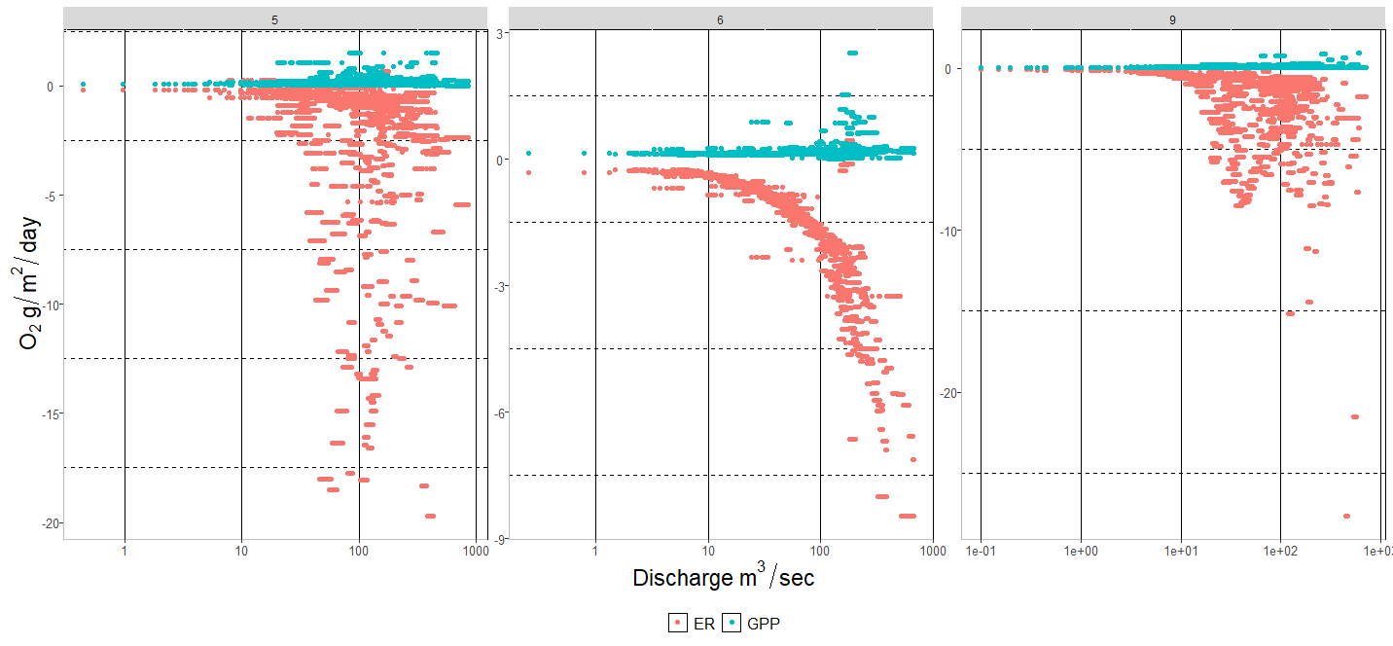
Notes:
Moving on to the stream metabolism results, here is a snapshot of three strea, displaying their GPP and ER relationship with Q. These results are largely preliminary , I have not applied my field measured K600 values. As expected, ER tends to increase with increasing discharge. GPP is minimal and overall NEP is largely negative. By comparing NEP- CO2 produced internally versus total CO2, there is a lot of overlap, and the margins between total CO2 and NEP are minima. They only outliers to this, of now, are stream 6 and 5a which again are unique sites. 5a is mega flashy and 6 belongs to a basin with dense wetland coverage. With this present data set, these figures represent to me that indicating these small headwater streams, are active players in carbon cycling

Slide 10
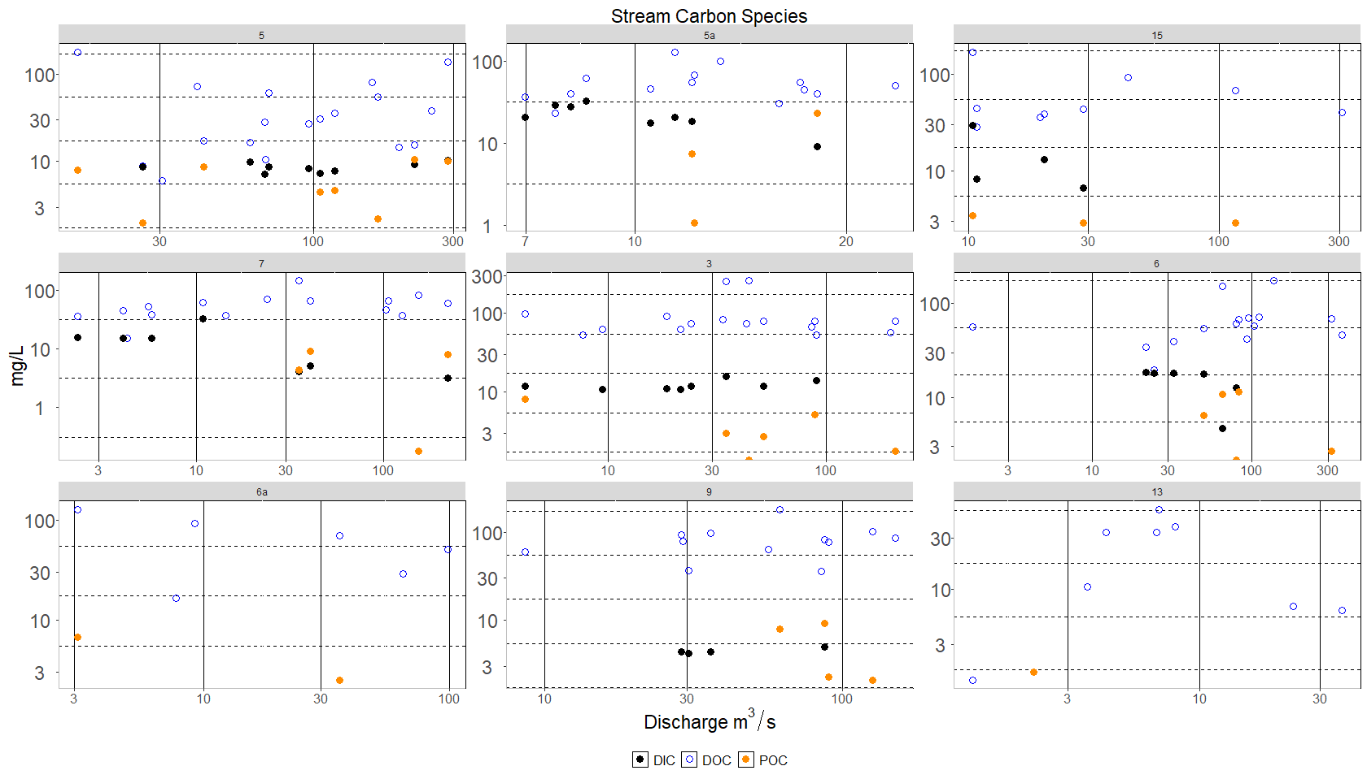
Notes:
As I mentioned, in addition to carbon and oxygen dynamics, I will observe the C-Q relationship of DIC, DOC, and POC- I have just yet to do so. Instead, here is a scatter plot of DOC in blue, POC in orange, and DIC in relation to changes in discharge. As seen in the literature, DOC increases with increasing Q- nothing new. POC and DIC still have too few data point to make any premature statements but as of now DIC does not seem to be affected by Q

Slide 11
Thank you! Questions?

Slide 12
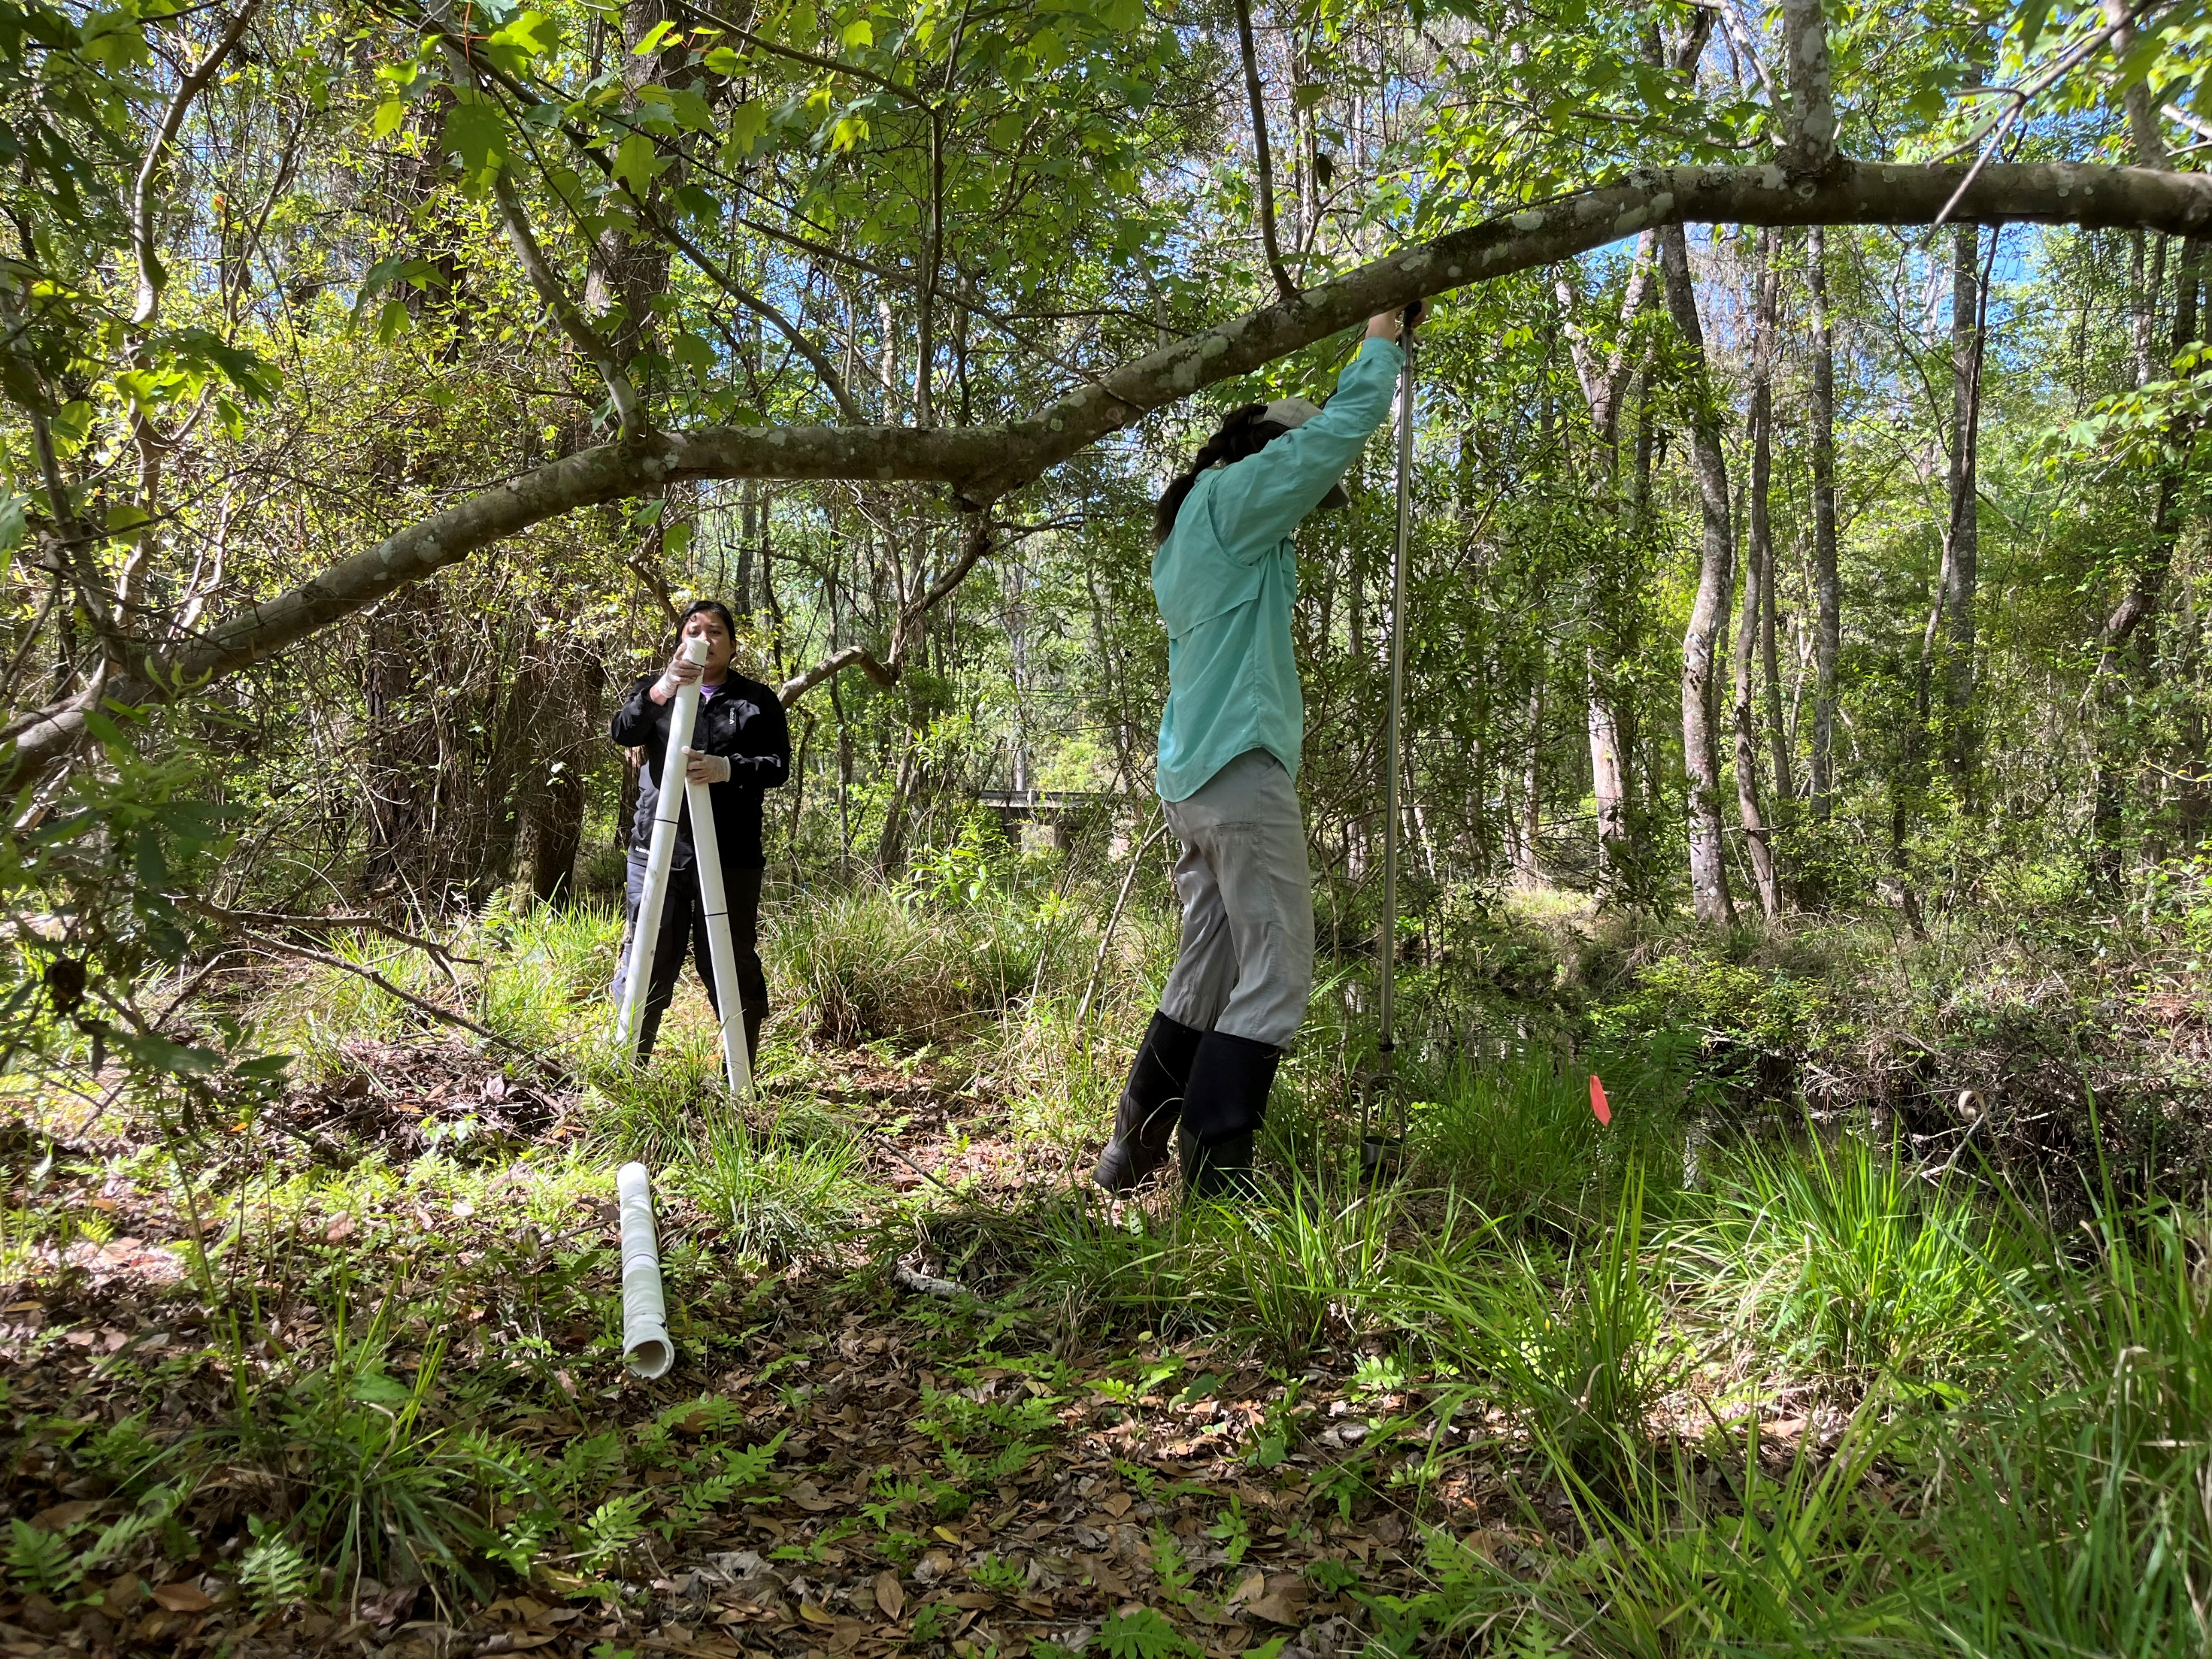
Chapter 2: Deployed wells laterally along the river corridor and within microenvironments
Notes:
Moving on to chapter 2, my objective is to understand carbon fluxes with in the river corridor- the stream and its riparian wetland. I am doing so by installing wells laterally along the river corridor and within microsites for groundwater sampling and point readings.
I visit my wells at the end of every month, so I am about 5 months into this project. I sample for DIC, DOC, FDOM, CO2 and methane,. I also take point readings of pH and CO2. Today I will only be showing results for DOC and pH because the rest are largely preliminary

Slide 13
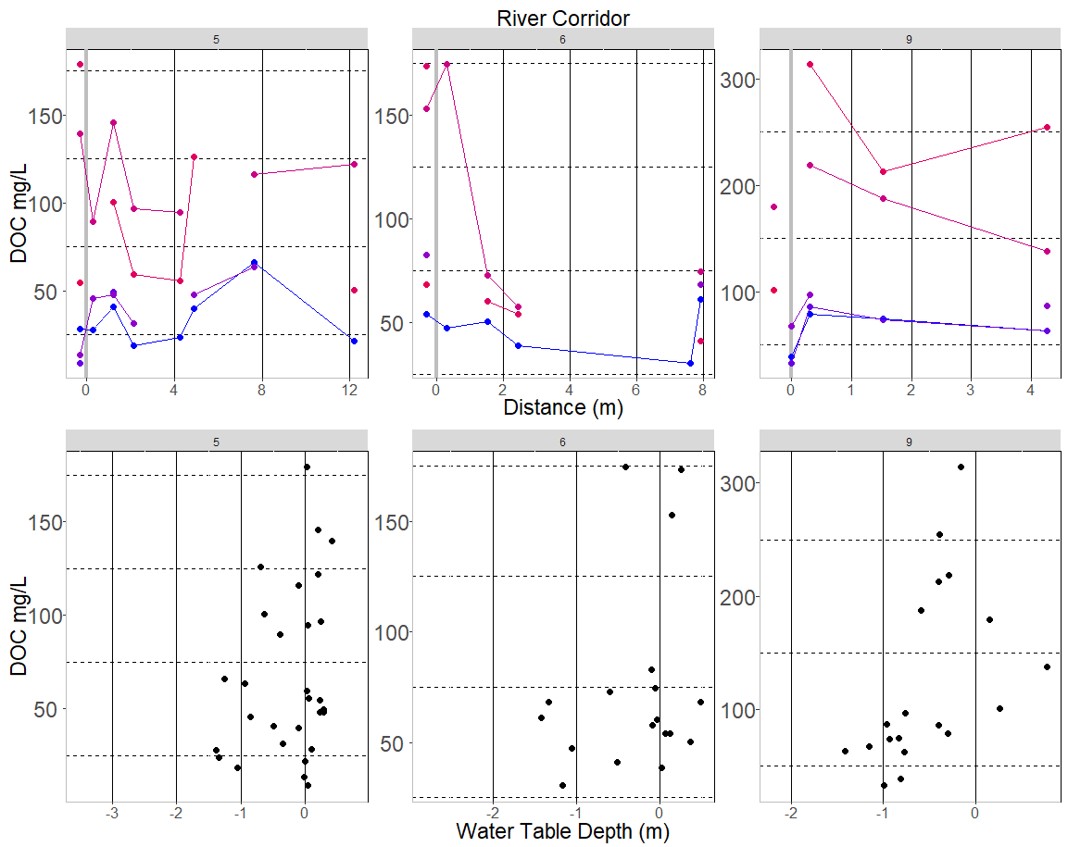
Notes:
The graph above displays DOC concentrations as you move farther from the stream with 0 being the stream boundary. I tried to connect the sampling events by lines for clearer referencing. To me, these results show that as you move farther from the stream but within the RC, high concentration of DOC, from 30 mg/L to above 100 mg/L) is maintained. I intend to deploy a well way in the uplands for reference, but we are waiting on equipment. Coming soon!
The bottom graph displays how DOC concentration change with water table depth. Some of these wells do go dry, and from my understanding the higher the water table, the greater the lateral transport, and it most cases this seems to be true. Across the sites, the higher the water table, the higher the DOC concentrations.

Slide 14
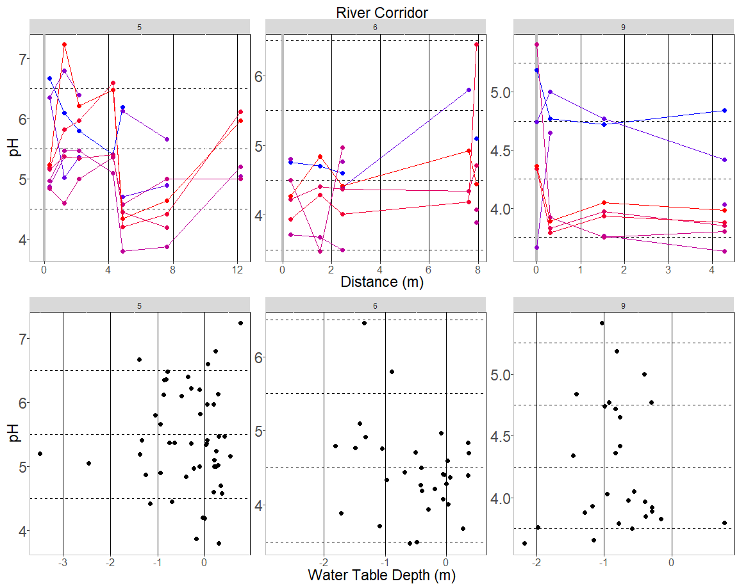
Notes:
Here are similar figures but instead I have pH. 5 shows this interesting U-shape are you move farther from the stream, pH seems to increase as you move father from the stream, and 9 stays relatively constant no matter the distance. This makes me very eager to process and figure out my CO2 and DIC data
Below, the trend between pH and water table depth are unclear. The mean for each site seems to be maintained no matter the water table depth. pH is not CO2 BUT pH is influenced by CO2… not jumping the gun but there seems to be cool story here and hopefully next semester I’ll have a clear depiction of what that is.

Slide 15
Thank you! Questions?

